Slide 1
International Health Care Management Part 1.1
Steffen Fleßa
Institute of Health Care Management
University of Greifswald

Slide 2
International Health Care Management
Basic textbook:

Slide 3
Structure
International Public Health
2 Demand for Health Services
3 Supply of Health Services
4 Health Systems and Reforms

Slide 4
Structure
International Public Health
1.1 Background
1.1.1 Health
1.1.2 Public Health
1.1.3 Health Economics
1. 1.4 Health Policy
1.2 Health and Development
1.3 Concepts

Slide 5
1.1.1 Health
“Health Care Management” = ?
Health = ?
Definition of the Constitution of the World Health Organisation (WHO), Geneva:
“Health is the state of complete physical, mental and social well-being and not merely the absence of disease or infirmity“ (WHO 1946)

Slide 6
Health: an alternative definition
“Health is the ability to recover from insults” (Meade, Florin, Gesler 1988)

Slide 7
Health and Age

Slide 8
1.1.2 Public Health
First mention: „Public Health Act“, 1848
first law on public health
United Kingdom
to improve sanitation and living standards in towns
England and Wales
Public Health („Volksgesundheit“): abuse in Nazi Regime (1933-1945)
better leave untranslated!
Health Science: broader than public health (includes Life Sciences)
Health Economics: can be seen as an element of public health

Slide 9
Definition
“Public Health is the science and art of preventing disease, prolonging life and promoting mental and physical health and efficiency through organised community efforts for the sanitation of the environment, the control of communicable infections, the education of the individual in personal hygiene, the organisation of medical and nursing services for the early diagnosis and preventive treatment of disease, and the development of social machinery to ensure to every individual a standard of living adequate for the maintenance of health, so organising these benefits as to enable every citizen to realise his birthright of health and longevity.” (WHO 1952)

Slide 10
Fields of Health Research

Slide 11
Fields of Public Health
Health Care Management
The art and science of managing (planning, organizing, staffing, leading, controlling) systems and organizations with the objective of improving the health of people
Primarily prescriptive: “how to do”

Slide 12
Epidemiology
Definition:
Science of the determinants (risk factors) and temporal as well as spatial diffusion of diseases or health conditions in populations, as well as the implementation of respective insights for the prevention and treatment of diseases
Biometrics
Statistical methods of quantitative data analysis for epidemiological models

Slide 13
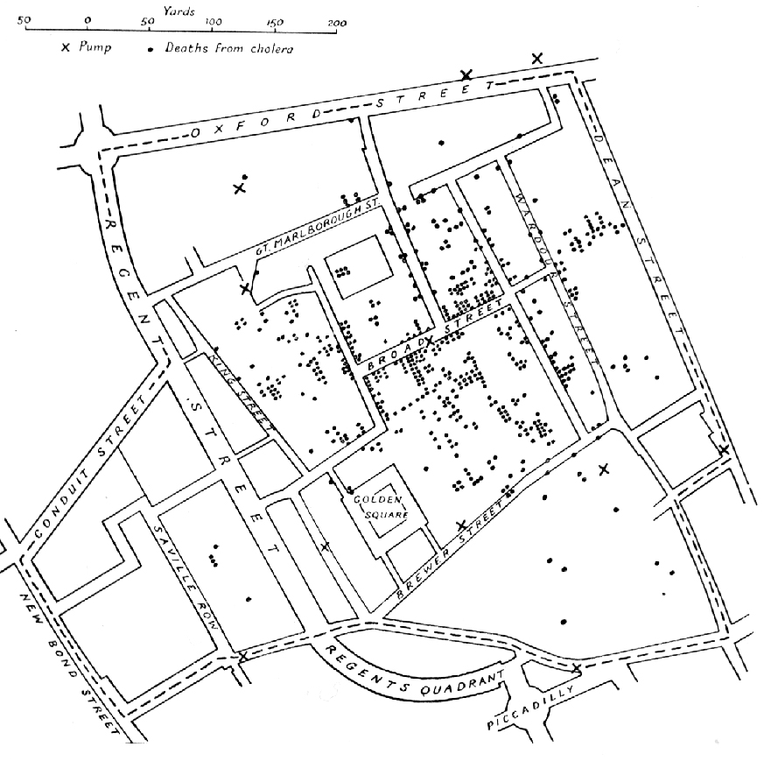
The beginning: map of cholera outbreak acc. to John Snow (London 1854)
http://de.wikipedia.org/w/index.php?title=Datei:Snow-cholera-map.jpg&filetimestamp=20051106111039

Slide 14
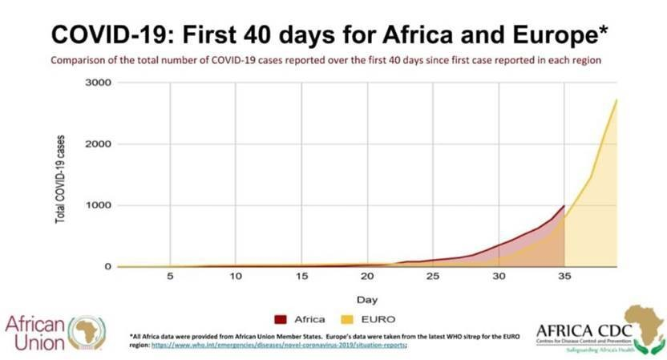
Diffusion in time and space
https://www.weforum.org/agenda/2020/04/africa-covid-19-time-bomb-defuse/

Slide 15
Academic Training in Public Health
Example: Master of Public Health, Harvard School of P.H.
Principles of Environmental Hygiene
Epidemiology
Statistics and Biometrics
Economics, Health Policy
Decision Theory
Health Care Management
Health Care in Low Income Countries
High overlap with HCM!

Slide 16
Training in Public Health in Germany
E.g. Berlin, Bielefeld, Bremen, Dresden, Düsseldorf, Hannover, Heidelberg, Munich, Ulm
Foci: e.g. urban health, occupational health, nursing care, disability, lay systems, civil society, children, health promotion, gender equity, systems research, dental health, aging, …

Slide 17
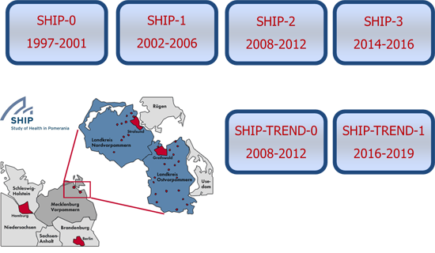
Community Medicine
CM and Public Health: no clear distinction
Principle:
CM is closer to medicine
Clearly distinct community (e.g. Pomerania)

Slide 18
Community Medicine
Criteria | Public Health | Community Medicine | Curative Medicine
Target Population | Population | Population of the region Individual | Single patient
Orientation | Prevention | Prevention | Cure of individual based on demand
Features | Central Messages | Screening Active approach Motivation Personal Interaction | Personal interaction on demand
Service | Social net | Social net Health care providers of the region Med. treatment in region | Medical treatment in region

Slide 19
1.1.3 Health Economics
Population
Needs

Slide 20
1.1.3 Health Economics
Population
Needs
Want
Demand

Slide 21
1.1.3 Health Economics
Population
Needs
Want
Demand
Supply

Slide 22
1.1.3 Health Economics
Culture – Religion - Ethics
Governance - Legal system – Economic system
Development Level – Gross National Product
Population
Needs
Want
Demand
Supply
Effectiveness - Efficiency

Slide 23
1.1.4 Health Policy and Health Politics
General:
Politics: science or art of governing or government, especially governing a political entity like a nation
Policy: overall plan that embraces the general goals and organizational processes
Health:
Health Politics i.n.s.: All governmental activities and instruments to plan, organize, implement and finance a health care system so that it can achieve its health goals
Development of a framework system for activities of health care providers, insurance schemes, pharmaceutical industry etc. by laws and regulations
Health Politics i.w.s.: all governmental activities and instruments with a direct or indirect impact on health-related aspects, i.e. education, work, nutrition, traffic, environment, family, …

Slide 24
Objectives of Health Politics
Sources:
General Declaration of Human Rights
Constitution of Federal Republic of Germany (Grundgesetz)
French Revolution
„Christian Occident“
Prime Value: Dignity
“Human dignity is inviolable”
Consequences for health politics?

Slide 29
Goal Conflicts

Slide 30
Goal Conflicts

Slide 31
Goal Conflicts

Slide 32
Goal Conflicts

Slide 33
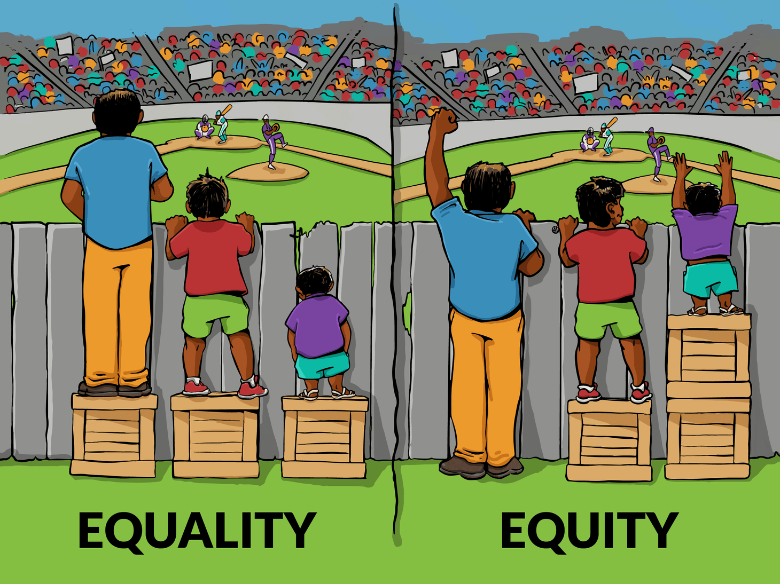
Objectives: Justice, Equity and Equality
Justice: philosophical concept of the morally correct assignment of goods and evils
Equality (Egalitarianism):
treating everyone the same
everybody receives the same
Equity:
“Equity is the absence of avoidable or remediable differences among groups of people, whether those groups are defined socially, economically, demographically, or geographically. Health inequities therefore involve more than inequality with respect to health determinants, access to the resources needed to improve and maintain health or health outcomes. They also entail a failure to avoid or overcome inequalities that infringe on fairness and human rights norms. “ (WHO)
“Treating equal things equally and unequal things unequally”
https://interactioninstitute.org/illustrating-equality-vs-equity/
https://www.who.int/healthsystems/topics/equity/en/

Slide 34
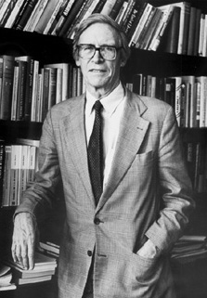
Justice
Need-based justice: everybody should be given as much as he/she needs
E.g. more health care resources should be given to sick and disabled
Who determines the needs?
Result-based justice: everybody should be given as much as he/she has contributed
E.g. if somebody pays more to an insurance, he/she should also receive better services
Process justice: fair rules should be applied to everybody
Fairness according to Rawls:
Fairness: a non-legal concept of justice
A situation is fair if it is favorable for the weakest
John Rawls
(1921-2002)

Slide 35
Goal Functions
Best average irrespective of distribution
Best situation for the weakest
Smallest possible deviation

Slide 36
Example
Income of Persons A, B, C in Years 2005, 2010, 2015, 2020
Person | 2005 | 2010 | 2015 | 2020
A | 300 | 330 | 100 | 300
B | 300 | 600 | 800 | 300
C | 300 | 900 | 1200 | 1200
Smallest possible deviation
Best situation of the weakest
Best average

Slide 37
Example
Income of Persons A, B, C in Years 2005, 2010, 2015, 2020
Person | 2005 | 2010 | 2015 | 2020
A | 300 | 330 | 100 | 300
B | 300 | 600 | 800 | 300
C | 300 | 900 | 1200 | 1200

Slide 38
Justice and Efficiency

Slide 39
How much health can we produce with given resources?
Which needs can we satisfy with given resources?
Which demand can we satisfy with given resources?
Which services can we produce with given resources?

Slide 40
Everybody has the same health status
Everybody satisfies his needs to the same extent
Everybody receives what he wants
Everybody receives what he can afford and achieve
Everybody receives the same service

Slide 41
Efficiency and Justice
(1),(2), (3),(4), (5): Pareto-Optimum
(6): inefficient

Slide 42
Efficiency and Justice
Health economists can state that (2), (3) and (4) are better than (6)
Health economists cannot state whether (1) and (5) are better than (6)
(1),(2), (3),(4), (5): Pareto-Optimum
(6): inefficient

Slide 43
Selected Objectives: Participation
Stakeholder: a person (group of persons, organization) with an interest or concern in something
Participation: stakeholders take part in processes affecting them
Types
Active participation: Taking part in development processes
Passive participation: Legitimation of decisions
Participation in health care
Patients are not only grateful receivers of „good deeds“ of health care providers but independent customers with rights
Strong regulation of health care providers by a democratic government

Slide 44
Selected Objectives: Participation
Stakeholder: a person (group of persons, organization) with an interest or concern in something
Participation: stakeholders take part in processes affecting them
Types
Active participation: Taking part in development processes
Passive participation: Legitimation of decisions
Participation in health care
Patients are not only grateful receivers of „good deeds“ of health care providers but independent customers with rights
Strong regulation of health care providers by a democratic government

Slide 45
Structure
International Public Health
1.1 Background
1.1.1 Health
1.1.2 Public Health
1.1.3 Health Economics
1. 1.4 Health Policy
1.2 Health and Development
1.3 Concepts

