Slide 1
International Health Care Management Part 1.2.4
Steffen Fleßa
Institute of Health Care Management
University of Greifswald

Slide 2
1.2 Health and Development
1 International Public Health
1.1 Background
1.2 Health and Development
1.2.1 Context
1.2.2 Static Concept of Development
1.2.3 Dynamic Concept of Development
1.2.4 Health Care in Developing Countries
1.3 Concepts

Slide 3
1.2.4 Health Care in Developing Countries
Development Goals of the WHO
Life Expectancy > 60 years
Infant Mortality < 50 per 1000
Child Mortality < 70 per 1000

Slide 4
https://ourworldindata.org/grapher/gdp-per-capita-worldbank

Slide 5
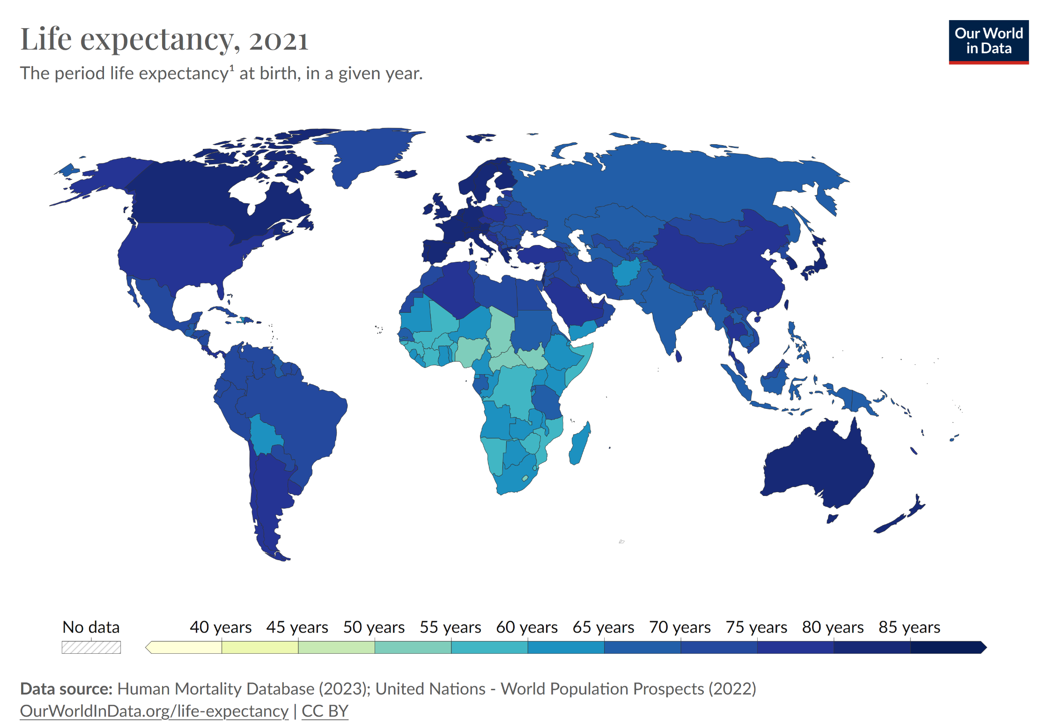
Life Expectancy (2021)
https://ourworldindata.org/grapher/life-expectancy-hmd-unwpp

Slide 6
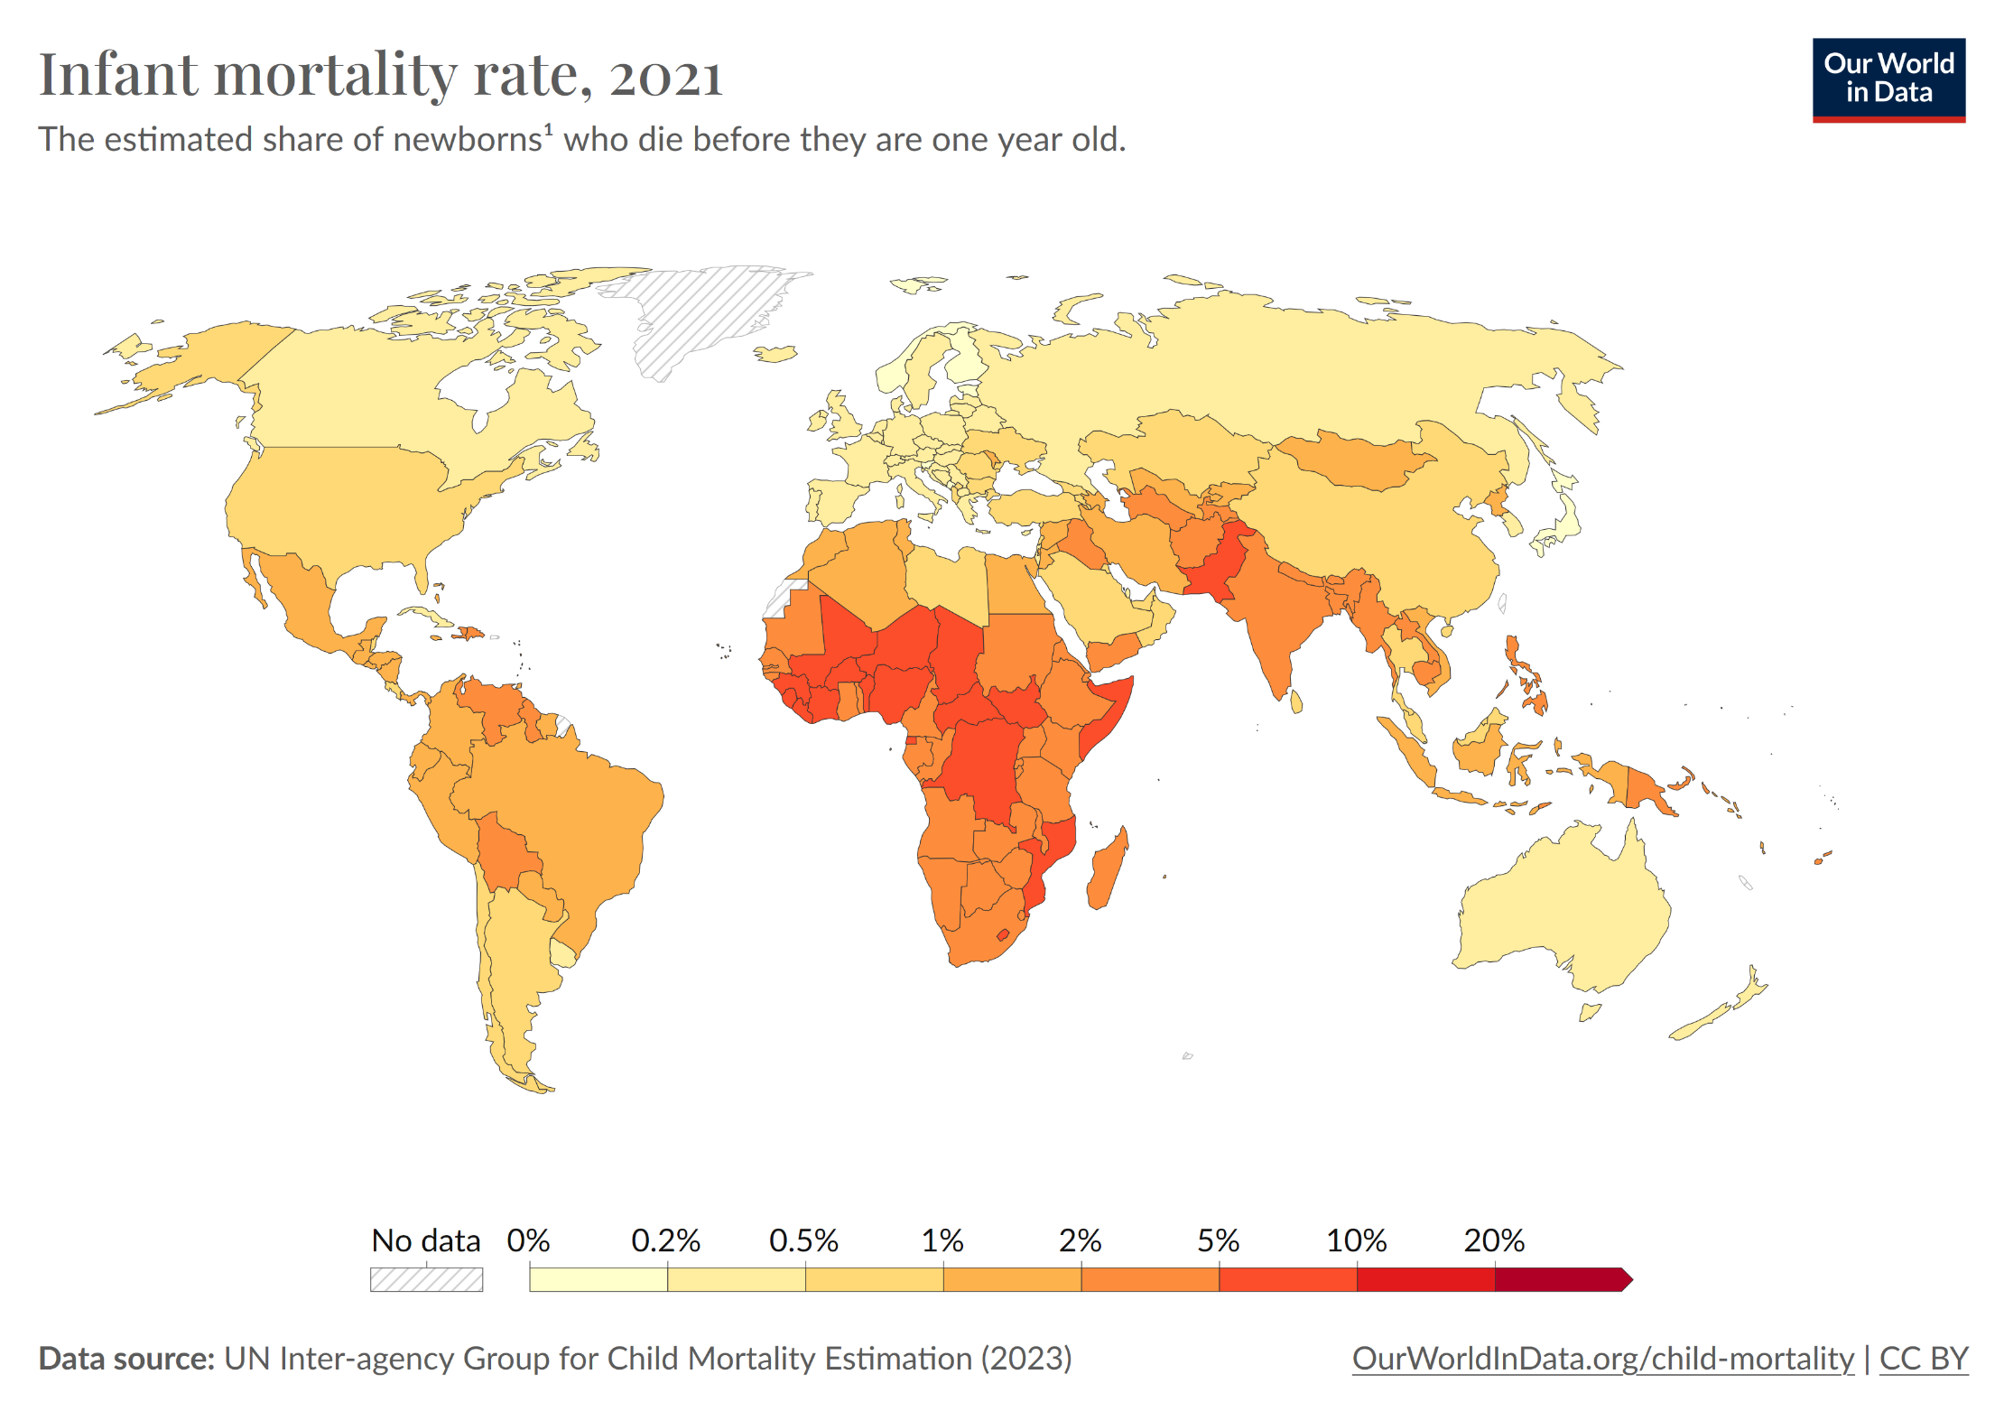
https://ourworldindata.org/grapher/infant-mortality
http://commons.wikimedia.org/wiki/File:Infant_mortality_rate_world_map.PNG

Slide 7
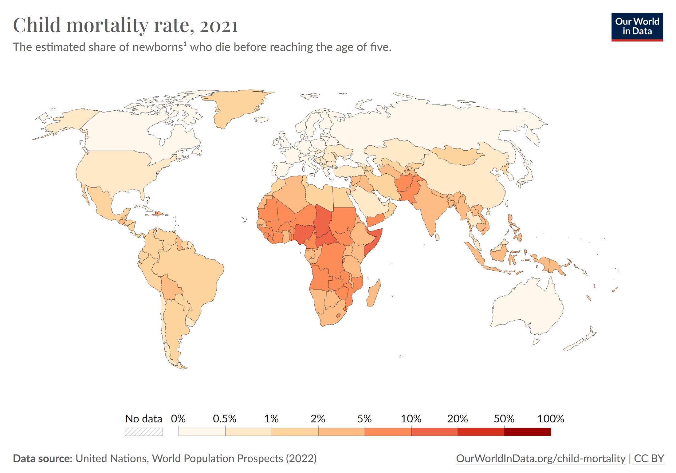
https://ourworldindata.org/grapher/child-mortality-around-the-world

Slide 9
Disease as Cause for Poverty
Human Diseases | Animal Origin
Measles | Cow (Rinderpest (word like in German))
Tuberculosis | Cow (Bovine Tuberculosis)
Pox | Cow (Bovine Pox) and other species with related pox viruses
Influenza | Pig, Duck
Whooping Cough | Pig, Dog
Malaria | Chicken, Duck, other birds
Aids | Monkeys, Apes
Constraint: Almost every infectious disease in humans is of animal origin. Transmission occurred through living closely to domestic animals.

Slide 10
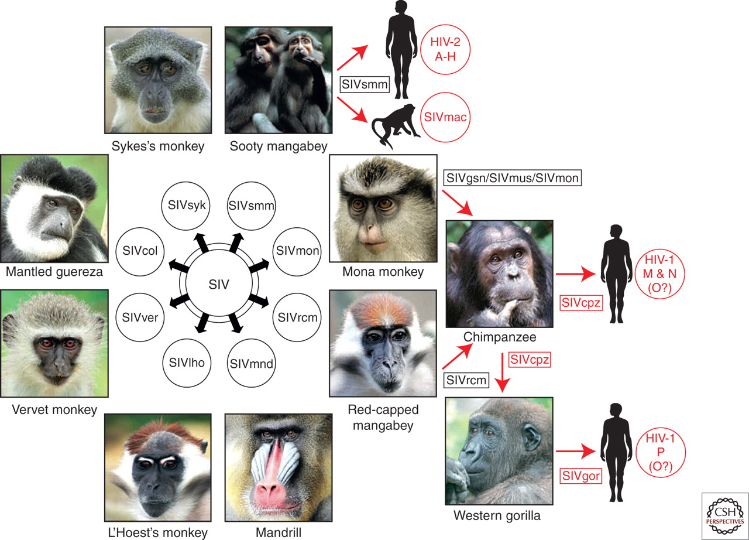
Origins of human AIDS viruses.
Paul M. Sharp, and Beatrice H. Hahn Cold Spring Harb Perspect Med 2011;1:a006841
©2011 by Cold Spring Harbor Laboratory Press
Notes:
Origins of human AIDS viruses. Old World monkeys are naturally infected with more than 40 different lentiviruses, termed simian immunodeficiency viruses (SIVs) with a suffix to denote their primate species of origin (e.g., SIVsmm from sooty mangabeys). Several of these SIVs have crossed the species barrier to great apes and humans, generating new pathogens (see text for details). Known examples of cross-species transmissions, as well as the resulting viruses, are highlighted in red.

Slide 11
http://www.montrealgazette.com/news/world/mythology+98patient+zero+aids+virus+travelled+united/12320042/story.html

Slide 12
Religion as Cause for Poverty
Max Weber: „Protestant ethics and the spirit of capitalism“
Examples:
Using resources of animal origin in religion
Role of women and gender competition
Fatalism
Linear versus cyclic development of human beings

Slide 13
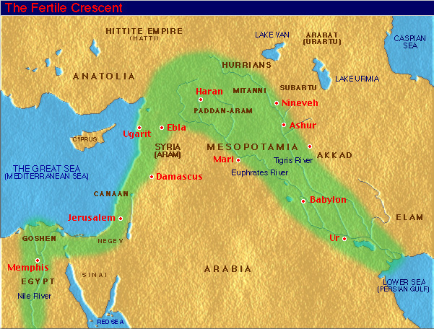
Nutrition as Cause for Poverty
Centers of Agricultural Origin in Independent Centers of Civilization:
West Africa
Fertile Crescent
Domestication of Plants: 8500 AD
Domestication of Animals: 8000 AD
China
New-Guinea
Eastern USA
Central America
Andes
Potentially Amazon
http://www.pbase.com/daveb/image/42673320

Slide 14
Nutrition as Cause for Poverty: Domestication
Region | Plants | Animals | Time
Fertile Crescent | Wheat, Peas, Olives | Sheep, Goat | 8500 BC
China | Rice, millet | Pigs, Silk Worm | 7500 BC
Central America | Corn, Beans, Pumpkin | Turkey | 3500 BC
Andes/ Amazon | Potato, Manioc | Lama, Guinea Pig | 3500 BC
Eastern USA | Sunflower | - | 2500 BC
Western Africa | Yam, Oil Palm | - | 3000 BC
New-Guinea | Banana, Sugarcane | - | 7000 BC

Slide 15
Nutrition as Cause for Poverty: Domestication
Precondition for Domestication of Plants
Annual plants
Plants high in protein
Large seeded plants (Wheat vs. Corn)
Seasonal climate with a distinct phase of ripening
High profitability
Hermaphrodite (Zwitterblütler) self pollinating plants

Slide 16
Natural Occurrence of Large Seeded Plants
Region | No.
Mediterranean Zone in Western Asia, Europe and Northern Africa | 33
Eastern Asia | 6
Sub-Sahara Africa | 4
North America | 4
Central America | 5
South America | 2
Australia | 2

Slide 17
Nutrition as Cause for Poverty: Domestication of Animals
Species | Time | Location
Dog | 10000 BC | Near East, China, North America
Sheep | 8000 BC | Near East
Goat | 8000 BC | Near East
Pig | 8000 BC | China, Near East

Slide 18
Species | Time | Location
Cow | 6000 BC | Near East, India, North Africa
Horse | 4000 BC | Central Asia
Donkey | 4000 BC | Egypt
Buffalo | 4000 BC | China
Lama / Alpaca | 3500 BC | Andes
Camel | 2500 BC | Central Asia
Dromedary | 2500 BC | Arabia

Slide 19
Nutrition as Cause for Poverty: Domestication of Animals
Precondition for Domestication
Efficient, simple nutrition in captivity
High growth rate
No fertility issues in captivity
No unpredictable nature
No tendency to stampede-like escape
High social hierarchy (human beings as herd leader)

Slide 20
Diffusion of Domesticated Plants and Animals
Starting Situation: Dependency of agriculture on climate (precipitation, temperature, seasons)
Habitat of same latitude usually show similar conditions in climate, habitat of same longitude show differing ones
Result: Diffusion on latitude is easier than on longitude
Result: Broader continents have better prospects of diffusion than long continents

Slide 21
Continental Axes

Slide 23
https://ourworldindata.org/grapher/life-expectancy

Slide 24
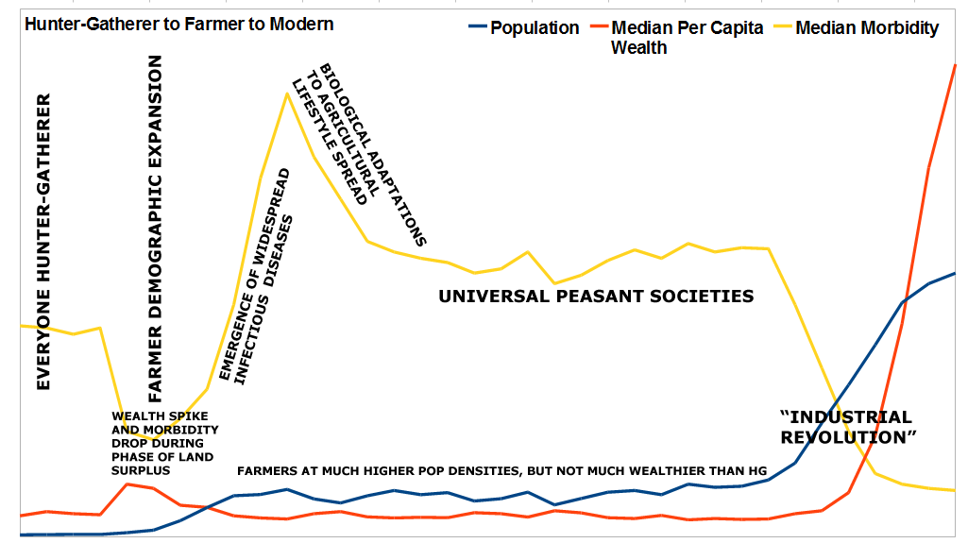
Population, Wealth and Morbidity
http://www.gnxp.com/blog/uploaded_images/modelhistory-795538.png

Slide 25
Life Expectancy United Kingdom
https://ourworldindata.org/life-expectancy/

Slide 26
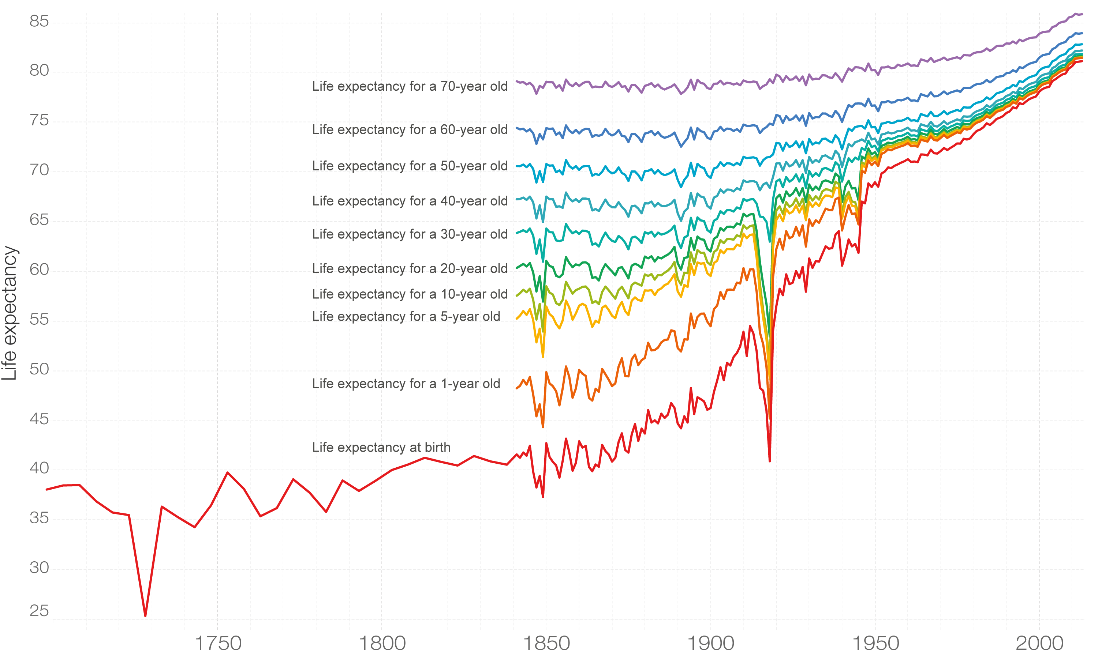
Rest Life Expectancy
https://ourworldindata.org/life-expectancy/

Slide 27
1.2 Health and Development
1 International Public Health
1.1 Background
1.2 Health and Development
1.2.1 Context
1.2.2 Static Concept of Development
1.2.3 Dynamic Concept of Development
1.2.4 Health Care in Developing Countries
1.3 Conceptions

