Slide 1
International Health Care Management Part 1.3.3
Steffen Fleßa
Institute of Health Care Management
University of Greifswald

Slide 2
1.3 Concepts
1 International Public Health
1.1 Background
1.2 Health and Development
1.3 Concepts
1.3.1 Prevention
1.3.2 Primary Health Care
1.3.3 Health Promotion
1.3.4 Recent Developments

Slide 3
1.3.3 Health Promotion
Paradigms:
Pathogenesis
Biological mechanism that leads to a diseased state
Why do people fall sick?
Salutogenesis
Medical approach focusing on factors that support human health and well-being rather than on factors that cause disease
How and where is health improved?
Politics:
First Internationale Conference on Health Promotion, WHO-meeting in Ottawa, 1986
World Health Assembly 1989: Approval of Ottawa Charter

Slide 4
Definition
“Health promotion is the process of enabling people to increase control over, and to improve, their health. To reach a state of complete physical mental and social wellbeing, an individual or group must be able to identify and to realize aspirations, to satisfy needs, and to change or cope with the environment. Health is, therefore, seen as a resource for everyday life, not the objective of living. Health is a positive concept emphasizing social and personal resources, as well as physical capacities. Therefore, health promotion is not just the responsibility of the health sector, but goes beyond healthy lifestyles to wellbeing.” (Ottawa Charter, 1986)
“Health promotion enables people to increase control over their own health. It covers a wide range of social and environmental interventions that are designed to benefit and protect individual people’s health and quality of life by addressing and preventing the root causes of ill health, not just focusing on treatment and cure.” (https://www.who.int/news-room/q-a-detail/what-is-health-promotion)

Slide 5
Elements
Good governance for health
Health promotion requires policy makers across all government departments to make health a central line of government policy. This means they must factor health implications into all the decisions they take, and prioritize policies that prevent people from becoming ill and protect them from injuries.
These policies must be supported by regulations that match private sector incentives with public health goals (e.g. tax policies on unhealthy or harmful products such as alcohol, tobacco, etc.
Health literacy
People need to acquire the knowledge, skills and information to make healthy choices, for example about the food they eat and healthcare services that they need. They need to have opportunities to make those choices. And they need to be assured of an environment in which people can demand further policy actions to further improve their health.
Settings
Cities, regions, hospitals, schools, … and other settings play a major role in promoting good health. Strong leadership and commitment is essential to health
https://www.who.int/news-room/q-a-detail/what-is-health-promotion#

Slide 6
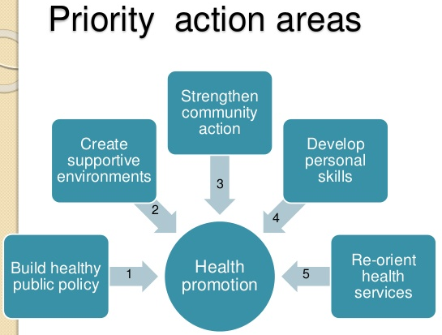
Health Promotion Strategies
build healthy public policy
Not only health policy – but healthy public policy!
create supportive environments
Healthy “worlds of living”
strengthen community action
“healing community”
develop personal skills
“health literacy”
reorient health services
Towards health promotion and prevention instead of curative medicine
Including all other services impacting on health
https://thelearner101.wordpress.com/2018/10/26/eds-143-module-3-health-education-and-health-promotion/

Slide 7
Health Promotion and Prevention
Health Promotion
Health Governance
Organisational Development (e.g. health promoting schools)
Prevention
Primary Prevention (e.g. vaccination programs)
Secondary Prevention (e.g. cancer screening programs)
Tertiary Prevention (e.g. rehabilitation)
Community Based Work (e.g. public transport)
Environmental Health (e.g. reused bags)
Health Education (e.g. Sexual Education)
Public Policy (e.g. banning public smoking)
Economic Regulation (e.g. tax on alcohol and tobacco)
https://www.slideshare.net/DrRoohiBanu/principles-of-health-promotion-disease-prevention

Slide 8
Examples
Healthy Cities
Health Promoting Regions
Healthy Schools
Health Promoting Hospitals
Occupational Health
...

Slide 9
1.3 Concepts
1 International Public Health
1.1 Background
1.2 Health and Development
1.3 Concepts
1.3.1 Prevention
1.3.2 Primary Health Care
1.3.3 Health Promotion
1.3.4 Recent Developments

