Slide 1
International Health Care Management Part 2.3.2
Steffen Fleßa
Institute of Health Care Management
University of Greifswald

Slide 2
2 Demand for Health Services
2.1 Determinants of Demand: Overview
2.2 Demographic and Epidemiologic Transition
2.3 Epidemiology of Infectious Diseases
2.3.1 Background
2.3.2 Example: Malaria
2.3.3 Example: Covid-19

Slide 3
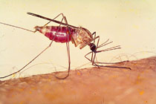
2.3.2 Malaria
Background:
Agent: Plasmodium (single cell organism)
Disease: Malaria (parasitosis)
Vector: Anopheles
Under Risk: 3.2 billion population worldwide, 97 countries
https://www.kfw-entwicklungsbank.de/PDF/Download-Center/
PDF-Dokumente-Development-Research/2015-08-13-EK_-Malaria.pdf

Slide 4
Case Figures 2022
Incidence: 249 million (official) cases
Over-Reporting: Fever = Malaria?
Under-Reporting: not treated, not diagnosed, …
94 % in Africa
Mortality
608,000 worldwide
850,000 (95%) in Africa
80% of all fatalities are children under age 5
https://www.who.int/news-room/fact-sheets/detail/malaria

Slide 5
https://ourworldindata.org/malaria

Slide 6
https://ourworldindata.org/malaria

Slide 7
Malaria as „Intermittent Fever“
Temperature (°C)
Day
91% of all cases and almost 100% of fatalities caused by Malaria Tropica (Plasmodium falciparum)

Slide 8
Worldwide Malaria Spread
Based on www.worldmalariareport.org/node/57

Slide 9
Cases of Malaria in Germany
Epidemiologisches Bulletin (Div. Years): http://www.rki.de/DE

Slide 10
Monthly Cases of Malaria in Mlowa Bwawani 1996 (own survey)
Time [Months]
Cases of Malaria

Slide 11
Malaria in Thailand

Slide 12
Malaria in Thailand

Slide 13
Malaria in Thailand

Slide 14
Malaria in Thailand

Slide 15
Malaria in Thailand

Slide 16
Malaria in Thailand

Slide 17
Malaria Protective Recommendations Cambodia http://www.giveapint.org/wp-content/uploads/2013/12/Cambodia.pdf

Slide 18
Economic Significance of Malaria
Loss of 10 Man-Days per Case of Malaria
Strong Seasonal Fluctuation
Malaria Control Programs
Malaria Eradication Program
Roll-Back-Malaria (WHO)
Cost estimates: 2.7 bio. US$ p.a.
https://www.kfw-entwicklungsbank.de/PDF/Download-Center/
PDF-Dokumente-Development-Research/2015-08-13-EK_-Malaria.pdf

Slide 19
Daily Occupancy Rate of Karatu Hospital 1995
Occupancy Rate
Time [Days]

Slide 20
Plasmodium Life Cycle

Slide 21
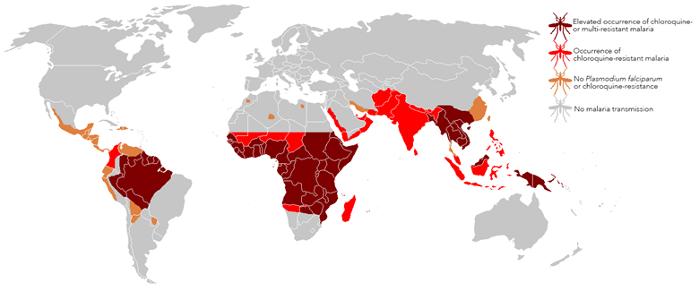
Chloroquine-Resistence
HIGH!
https://www.lshtm.ac.uk/research/centres/malaria-centre/news/104306/whats-deal-chloroquine-read-our-expert-view

Slide 22
Prognosis of Dynamic Systems
Concepts:
Biometric Models
Analytic Models
Markov-Models
System Dynamics Models

Slide 23
Bio / Econometric Models

Slide 24
Analytic Models, i.e. Ross-McDonald-Model
R₀
m
a
b₁
b₂
r
μ
basic reproductive rate
number of mosquitos
number of bites
infection risk of humans
infection risk of mosquito
recovery rate of humans
mortality of mosquito

Slide 25
Markov-Models
a
12
w₂
a
24
a
21
a
42
w₁
a
14
w₄
a
41
a
32
a
23
a
31
a
34
a
13
w₃
a
43

Slide 26
Markov-Model

Slide 27
System Dynamics Model

Slide 28
System Dynamics of Anopheles

Slide 29
System Dynamics of Anopheles

Slide 30
System Dynamics of a Population
Year | Population (Bt)
0 | Bo=100,000
1 | 105,000
2 | 110,250
3 | 115,763
4 | 121,551
5 | 127,628
6 | 134,010
7 | 140,710
8 | 147,746
9 | 155,133
10 | 162,889
0.05∙B_{t}

Slide 31
System Dynamics of Anopheles

Slide 32
System Dynamics of Anopheles

Slide 33
System Dynamics of Anopheles

Slide 34
System Dynamics of Anopheles

Slide 35
Seasonal Influences on the Population of Anopheles
Variance
Time [Months]
Anoph. Region 1
Anoph. Region 2
Temperature
Precipitation

Slide 36
Prevalence and Incidence (in % of Population)
Prevalence
Incidence
Time [Days]
Incidence
Prevalence

Slide 37
Anopheles Population and Malaria
Prevalence
Mosquitoes
Time [Months]
Anopheles
Malaria

Slide 38
Infections and In-door-Spraying
Infections
Time [Years]

Slide 39
Sustainability of In-door-Spraying, Infections
Infections
Time [Years]
B=25 years
B=5 years

Slide 40
Use of Bed Nets
https://www.nature.com/articles/s41467-021-23707-7

Slide 41
Bed Net Programs
Simon (2013) based on National Burreau of Statistics, Dar-es-Salaam

Slide 42
Infections and Bed Net Programs
Infections
Time [Years]
25 years
5 years

Slide 43
Fatalities and Bed Net Programs, Region 2
Infections
Time [Years]
25 years
5 years

Slide 44
Anopheles Population at Rising Temperatures
Anopheles
Time [Years]
Rise, R1
Rise, R2

Slide 45
Infections at Rising Temperatures
Infections
Time [Years]
Rise, R1
Rise, R2

Slide 46
Infections and El-Nino
Infections
Time [Years]

Slide 47
Infections and Resettlement Programs
Infections
Time [Years]

Slide 48
Fatalities and Resettlement Programs
Time [Years]

Slide 49
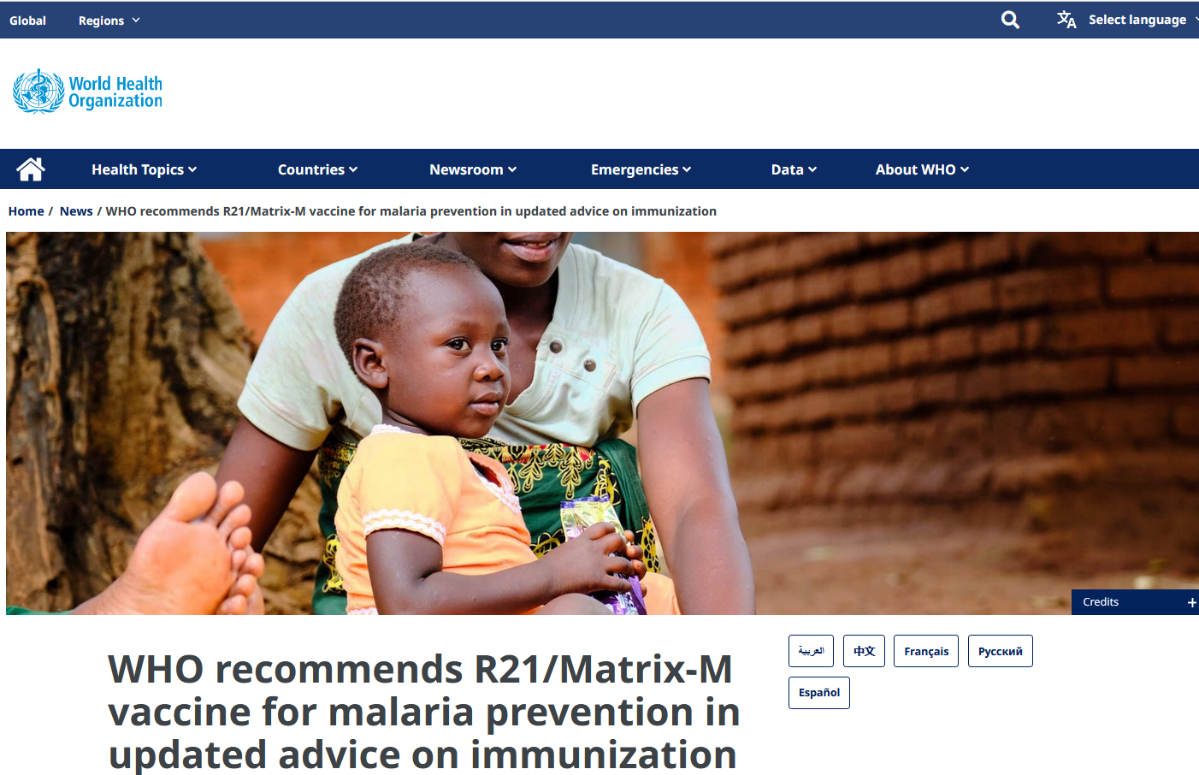
Vaccination
Situation 2024:
Mosquirix (RTS,S/AS01, GlaxoSmithKline ) and R21/Matrix-M recommended
Prevention of malaria in children
4 doses from around 5 months of age
Success?
Mortality in Children: - 13 %!
Vaccination against parasites extremely difficult
Vaccination against a disease that causes only semi-immunity extremely difficult
4 doses?

Slide 50
2 Demand for Health Services
2.1 Determinants of Demand: Overview
2.2 Demographic and Epidemiologic Transition
2.3 Epidemiology of Infectious Diseases
2.3.1 Background
2.3.2 Example: Malaria
2.3.3 Example: Covid-19

